Slide 1

MEDICAF BY TEAM ARYAN
PS: “Presently, the healthcare system is inefficient in hospital operations, poses a danger of unlawful narcotic medication sales, and issues with obtaining patient-prescribed medicine data, requiring the community to store a large number of receipts for medicines from each visit. Challenges in our healthcare journey aren't merely structural; they have a tremendous impact on people's lives. Delays in operations cause patients to suffer and strain providers. The threat of illegal drug sales hovers over our neighborhoods. Accessing patient data might be quite a challenge. Let us instill compassion and creativity in healthcare, making every second count for those who rely on it.”

Slide 2

IDEA/APPROCH
We propose a medical oversight website with features like QR-coded prescriptions and a centralized database to address these challenges.
Improve Efficiency: Streamline hospital procedures to enhance overall efficiency and reduce administrative burdens on healthcare professionals.
Prevent Unauthorized Drug Sales: Implement robust security measures to prevent the illegal sale of narcotic drugs and promote responsible healthcare practices.
Enhance Access to Prescribed Medicine Data: Create a centralized database for easy and secure access to prescribed medicine information, benefiting both healthcare providers and patients.
To improve the efficiency of hospital procedures, provide intuitive workflows for physicians, nurses, and administrative personnel. Allow for effective appointment, admission, and discharge management.
Integrate a QR code system for prescriptions to make it easier to check and correctly deliver drugs. Make certain that only authorized people may produce and access these codes.
Create a safe, centralized database to hold patient data such as medical history, medicines, and treatment plans. To preserve patient privacy, use data encryption and backup techniques.
To prohibit the illicit selling of narcotic medications, implement strict monitoring and reporting methods. Create a scalable system that can accommodate future expansion and new features.
Consider incorporating new technology, such as telemedicine capabilities. Allow for the tracking of narcotic medication prescriptions and dispensations in real time.

Slide 3
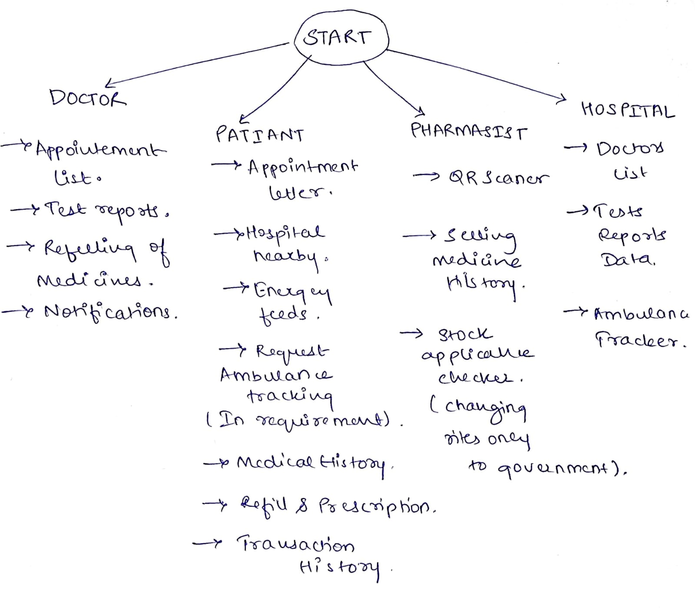
Features:
QR-Coded Prescriptions.
Centralized Database.
Authorization and Authentication.
Medication Tracking.
Drug Interaction Alerts.
Audit Trail.
Reporting and Analytics.
Integration with EHR Systems.
Compliance with Regulations.
Training and Support.

Slide 4

Future features for our application!
Blockchain Technology for Data Security: Use blockchain technology to improve data security and integrity. The immutability of patient information and prescription data may be ensured via blockchain, decreasing the danger of tampering or illegal access.
AI and Machine Learning (ML): Implement AI and ML algorithms for predictive analytics, fraud detection, and anomaly identification. AI can assist in identifying strange prescription trends as well as potential security breaches.IoT (Internet of Things) Devices: Connect IoT devices and sensors in real-time to monitor medication adherence, patient vital signs, and inventory management. For full control, this data can be merged into the centralized database.
Integration of Telemedicine: Create a telemedicine module within the website to enable remote consultations, minimizing the need for physical visits and increasing access to healthcare services.
Create companion mobile apps for patients and healthcare professionals that offer quick access to medical records, medication information, and appointment booking on smartphones or tablets. Big Data Analytics: Use big data analytics to extract information from massive datasets.
This can aid in the improvement of healthcare outcomes, the optimization of resource allocation, and the identification of patterns in patient care. Biometric Authentication: Use biometric authentication technologies (such as fingerprint or face recognition) to improve user security and simplify platform access. Integrate speech recognition and natural language processing (NLP) capabilities to enable for voice-controlled data entry and retrieval, making the system more user-friendly. Explore Augmented Reality (AR) and Virtual Reality (VR) applications for medical training, operation simulations, and patient education.
Data Interoperability Standards: To enable smooth data sharing across different healthcare systems and institutions, use interoperability standards such as HL7 and FHIR.5G Connectivity: Take advantage of 5G networks for quicker and more reliable data transfer.

Slide 5
THANK YOU BY TEAM ARYAN

